Slide 1
SEARS-MT and Indonesian Perspective
Fadjar Shadiq
fadjar_p3g@yahoo.com
www.fadjarp3g.wordpress.com

Slide 2
PowerPoint Presented on SEAMEO-RECSAM and University of Tsukuba Joint Symposium 16 February, 2015

Slide 3
Personal Identity
Name: Fadjar Shadiq, M.App.Sc
Place and Date of Birth: Sumenep, 20-4-55
Education: Unesa (Surabaya Teachers Colleage) and
Curtin University of Technology, Perth, WA
Teaching Experience:
SHS Mathematics Teacher. Instructor and Teacher Trainer
(0274)880762; 08156896973
fadjar_p3g@yahoo.com & www.fadjarp3g.wordpress.com

Slide 4
Even dan Ball (2009:1): “ ... teachers are key to students’ opportunities to learn mathematics.”
Students should be the focus.
Therefore we need teacher whose actions promoting student learning.
Notes:
How to help our children.

Slide 5
In the past Mathematics is known as deductive-axiomatic subject.
Children only as follower.

Slide 6
Lakatos was quoted by Burton (1992:2) states:
“Deductivist style hides the struggle, hides the adventure. The whole story vanishes; the successive tentative formulations of the theorem in the course of the proof-procedure are doomed to oblivion while the end result is exalted into sacred infallibility.”

Slide 7
Children only as follower.
How to help them to:
Be Innovative
Be Creative

Slide 8
George Polya (1973: VII): “Yes, mathematics has two faces; … . Mathematics presented in the Euclidean way appears as a systematic, deductive science; but mathematics in the making appears as an experimental, inductive science.”

Slide 9
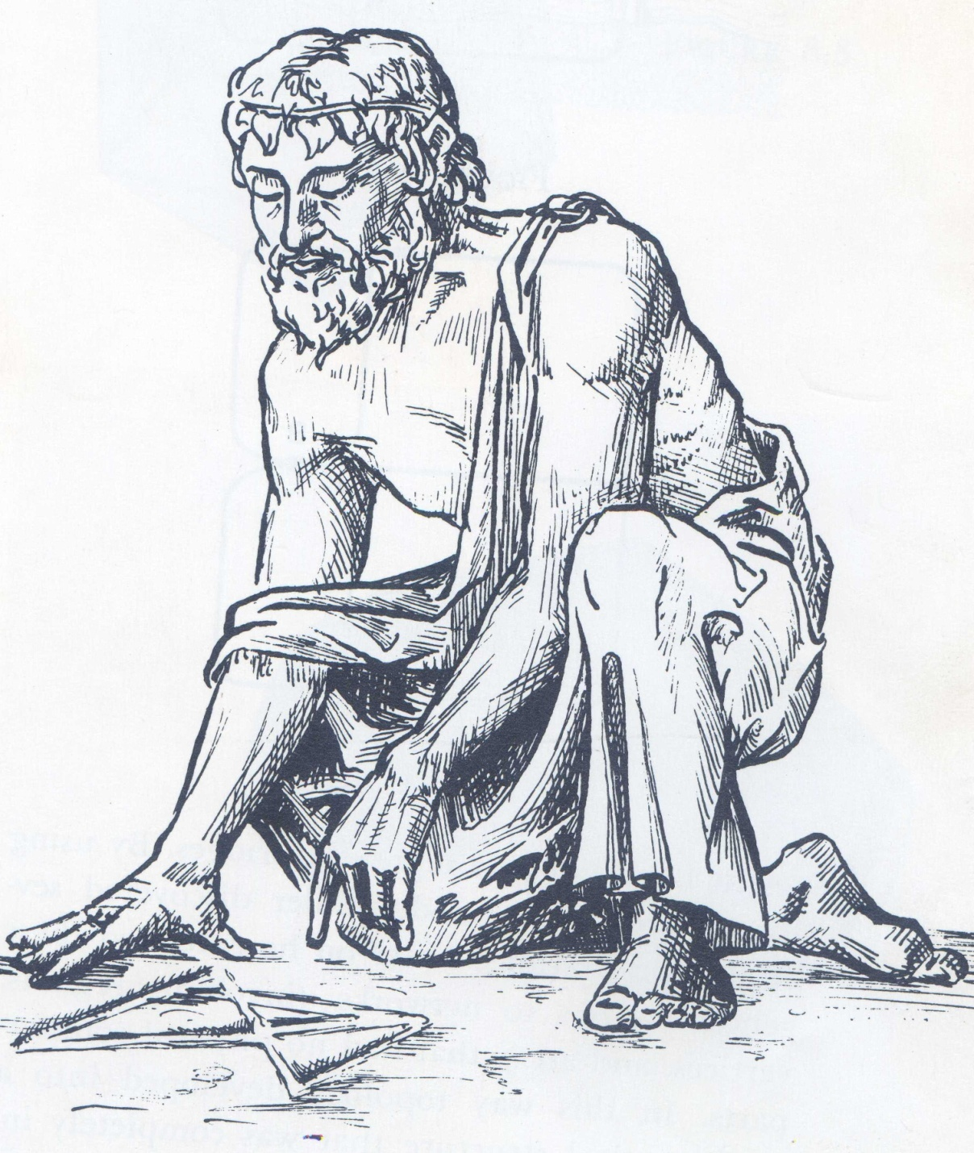
Pythagoras
Source: NCTM
What can you say regarding this picture
Bruner: Discovery Learning is Learning to Discover
Notes:
As mathematics teachers, we have to facilitate our children to learn to explore and to reinvent.

Slide 10
What is Mathematics?
De Lange (2005) stated: “Mathematics could be seen as the language that describes patterns – both patterns in nature and patterns invented by the human mind.”

Slide 11
The Four Important Questions:
“How to Help Our Students to Learn Mathematics:
Meaningfully → easily?
joyfully?
to use their heads (think)?
to be an independent learner?”

Slide 12
Scientific Approach in Indonesia
Observing
Questioning
Experimenting
Reasoning
Communicating
Notes:
The Scientific Approach should be implemented in Ind under the 2013 New Curr

Slide 13
The PSA (Jap) and the Scientific Approach (Ind)
1. Problem Posing
2. Independent Solving (The first 4 steps on SA: FS)
3. Comparison and Discussion (the last step on SA: FS)
4. Summary and Integration.
Source: Masami Isoda
Notes:
The PSA (Jap) can be used and support the Scientific Approach (Ind)

Slide 14
Four Competencies of an Indonesian MT
Pedagogical Competencies
Professional Competencies
Social Competencies
Personal Competencies
Notes:
Competencies consist of three aspects:
Knowledge
Skills
Attitude

Slide 15
Four Categories for Indonesian MT
Beginner Teachers (GURU PERTAMA)
Young Teachers (GURU MUDA)
Associate Teachers (GURU MADYA)
Master Teachers (GURU UTAMA)

Slide 16
SEARS-MT
Must be ….
Should be ….
Might be ….
Notes:
Because of ‘standard’ is a minimum requirement, then SEARS-MT must be achieved by MT.

Slide 17
The Use of SEARS-MT
As a basis in completing the four competencies of an Indonesian MT.
To assess: Knowledge → Testing, Skills → Observing and Attitude →questionaire or interviewing.
For SEAMEO QiM, as a basis in enrich the competencies of MT in SEAMEO member countries.

Slide 18
The Questions
Should practitioner teachers achieve the knowledge of the theory of discipline of mathematics?
What about teaching aids?

Slide 19
Reference
Even R.; Ball, D.L. (2009). Setting the stage for the ICMI study on the professional education and development of teachers of mathematics. In Even R.; Ball, D.L. (Eds). The Professional Education and Development of Teachers of Mathematics. New York: Springer
Burton, L. (1992). Implications of constructivism for achievement in mathematics. In 7th International Congress on Mathematical Education (ICME-7). Topic Group 10; Constructivist Interpretations of Teaching and Learning Mathematics. Perth: Curtin University of Technology.
Isoda, M. & Katagiri, S. (2012). Mathematical Thinking. Singapore: World Scientific.
Polya, G. (1973). How To Solve It (2nd Ed). Princeton: Princeton University Press.

Slide 20
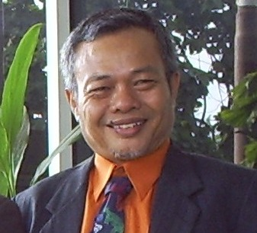
The End
Thank You
Very Much

